Slide 1
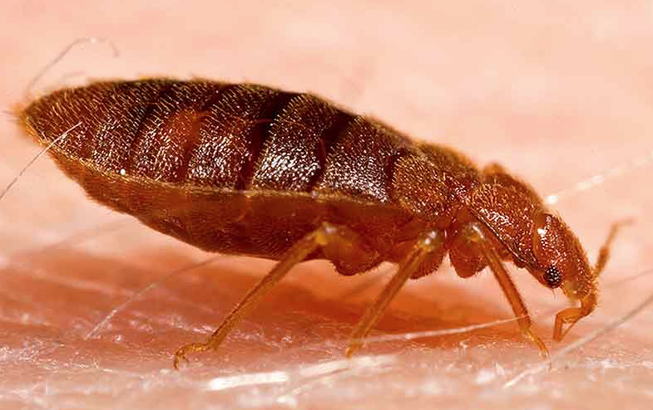


Pesticide Resistance in Bed Bugs and Bed Bug Management
Shujuan (Lucy) Li
University of Arizona
Notes:
1

Slide 2
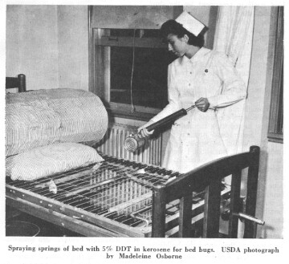
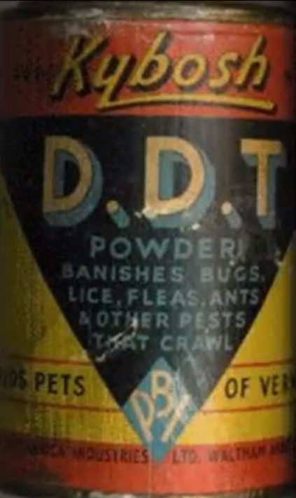
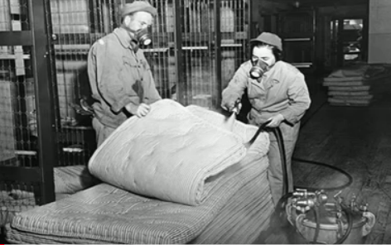
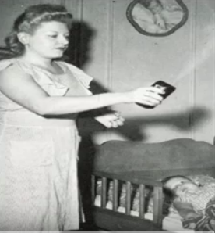
Bed bugs were virtually eradicated from the U.S. in the post WWII era due to DDT and other powerful insecticides.

Slide 3
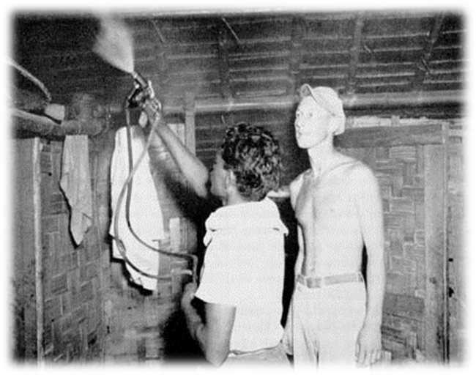
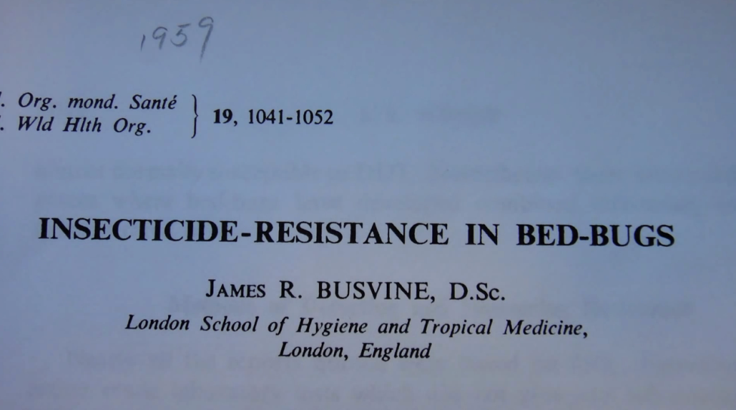
By the 1960s, bed bugs had developed resistance to DDT, methoxychlor and analogues, BHC, dieldrin and analogues, and pyrethrins (Busvine 1958, Cwilich & Mer 1957, Mallis and Miller 1964).
Products, vendors, or commercial services mentioned or pictured in this seminar are for illustrative purposes only and are not meant to be endorsements.

Slide 4
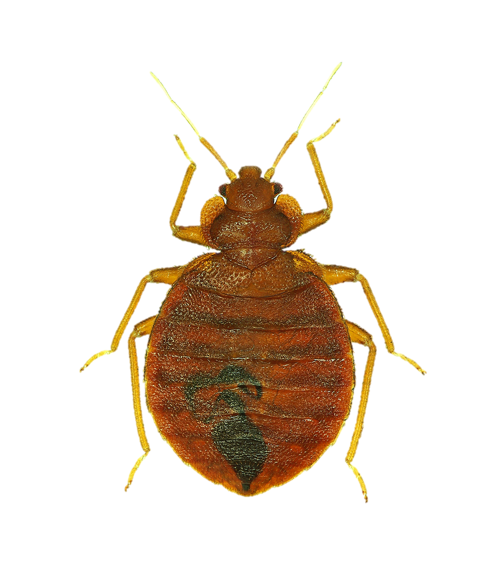
Public housing
Apartments
Schools
Hospitals
Nursing homes
Homes
Child care
Medical facilities
Transportation
Hotels & motels
Health care facilities
Airports
Movie theaters
Department stores
Everywhere!!!!!

Slide 5
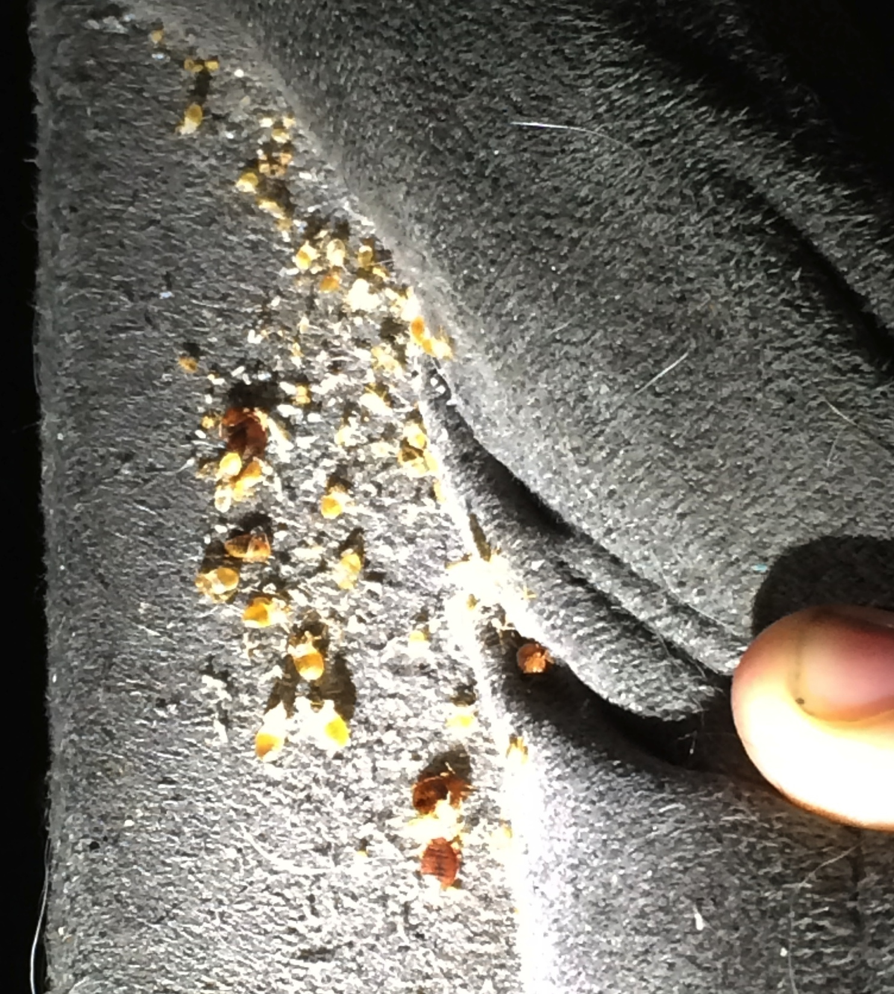
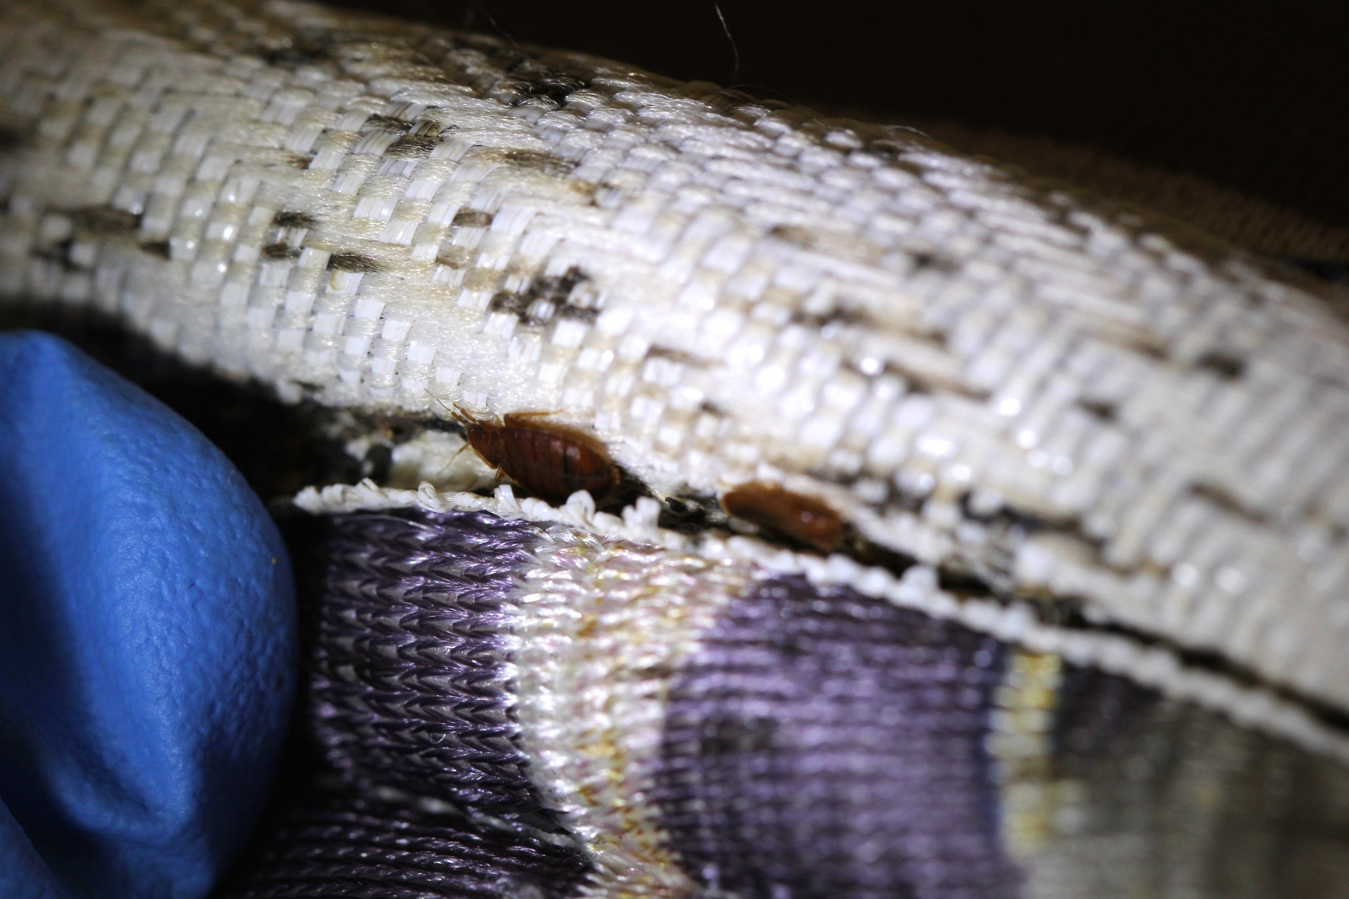
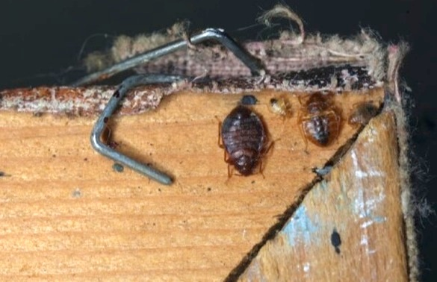
Have you seen these after treatments?

Slide 6
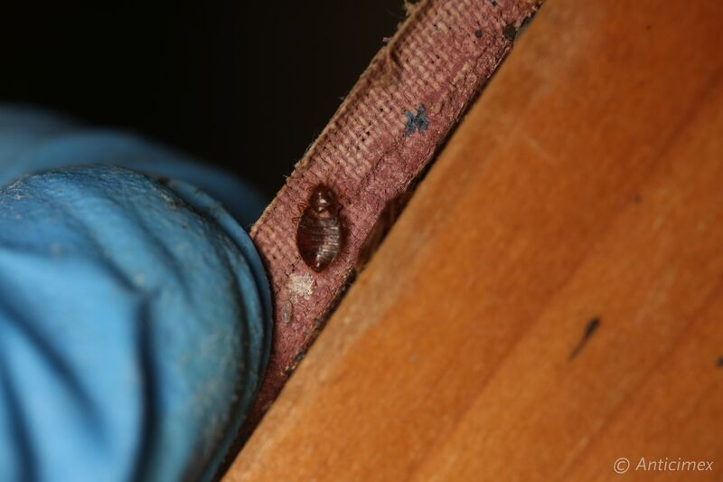

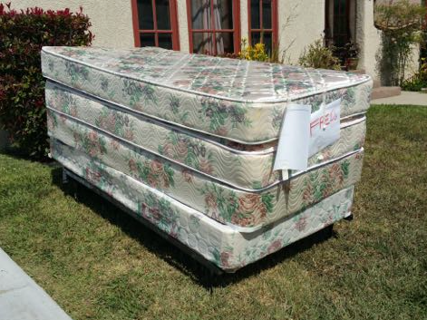


Possible reasons for treatment failure?
Missed some
Clutter
Reintroduction

Slide 7
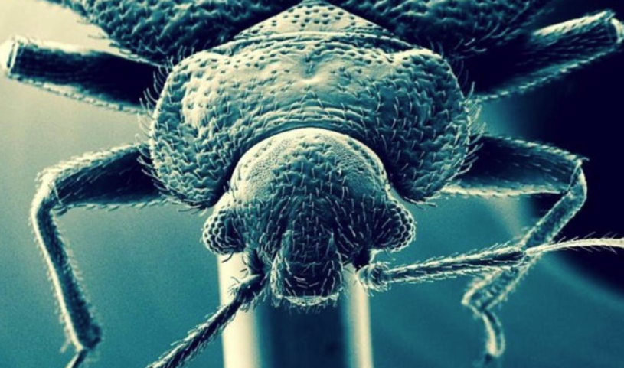
Why an Insecticide Fails?
Resistance
Incorrect dilution
Incorrect application rate
Out of date
Incorrectly stored
Harborages not treated
Poor staff training

Slide 8
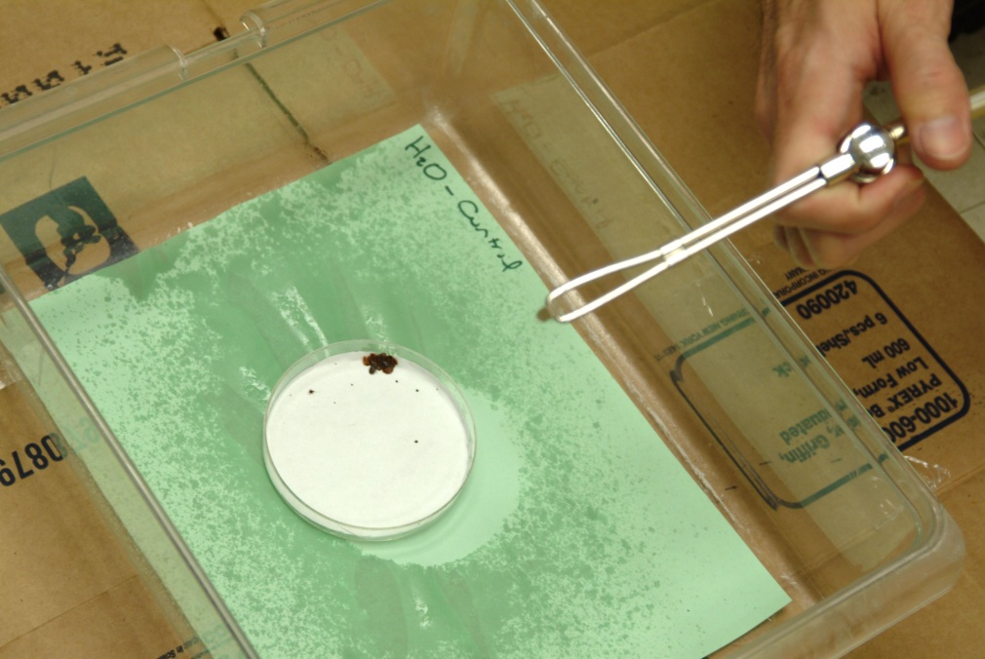
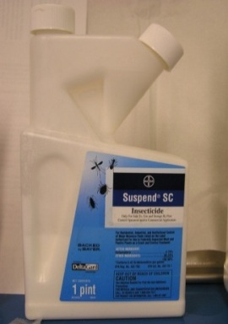
Bed bugs survived direct insecticide sprays
.
Suspend® (Deltamethrin)
Products, vendors, or commercial services mentioned or pictured in this seminar are for illustrative purposes only and are not meant to be endorsements.

Slide 9
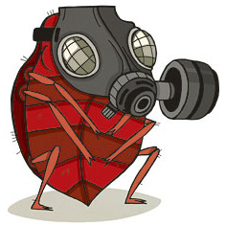
Dose-response assays for field-collected strains
Resistance ratio (RR) at least 6,000 !!!
Romero et al. (2007) J. Med. Entomol.

Slide 10
Pesticide Resistance
Describes the decreased susceptibility of a pest population to a pesticide that was previously effective at controlling the pest.
Occurs when a population of insects builds up a tolerance to a specific chemical, or group of chemicals with the same Mode of Action, or the mechanism by which the chemical causes death in the pest.
Pests evolve pesticide resistance via natural selection: the most resistant individuals survive and pass on their genetic traits to their offspring.

Slide 11
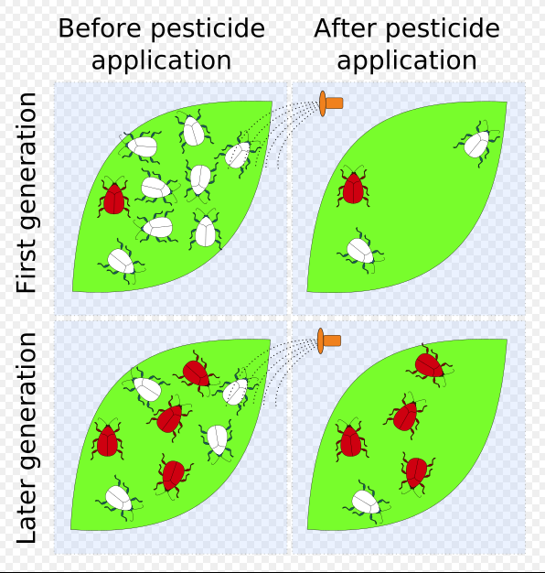
https://en.wikipedia.org/wiki/Pesticide_resistance

Slide 12
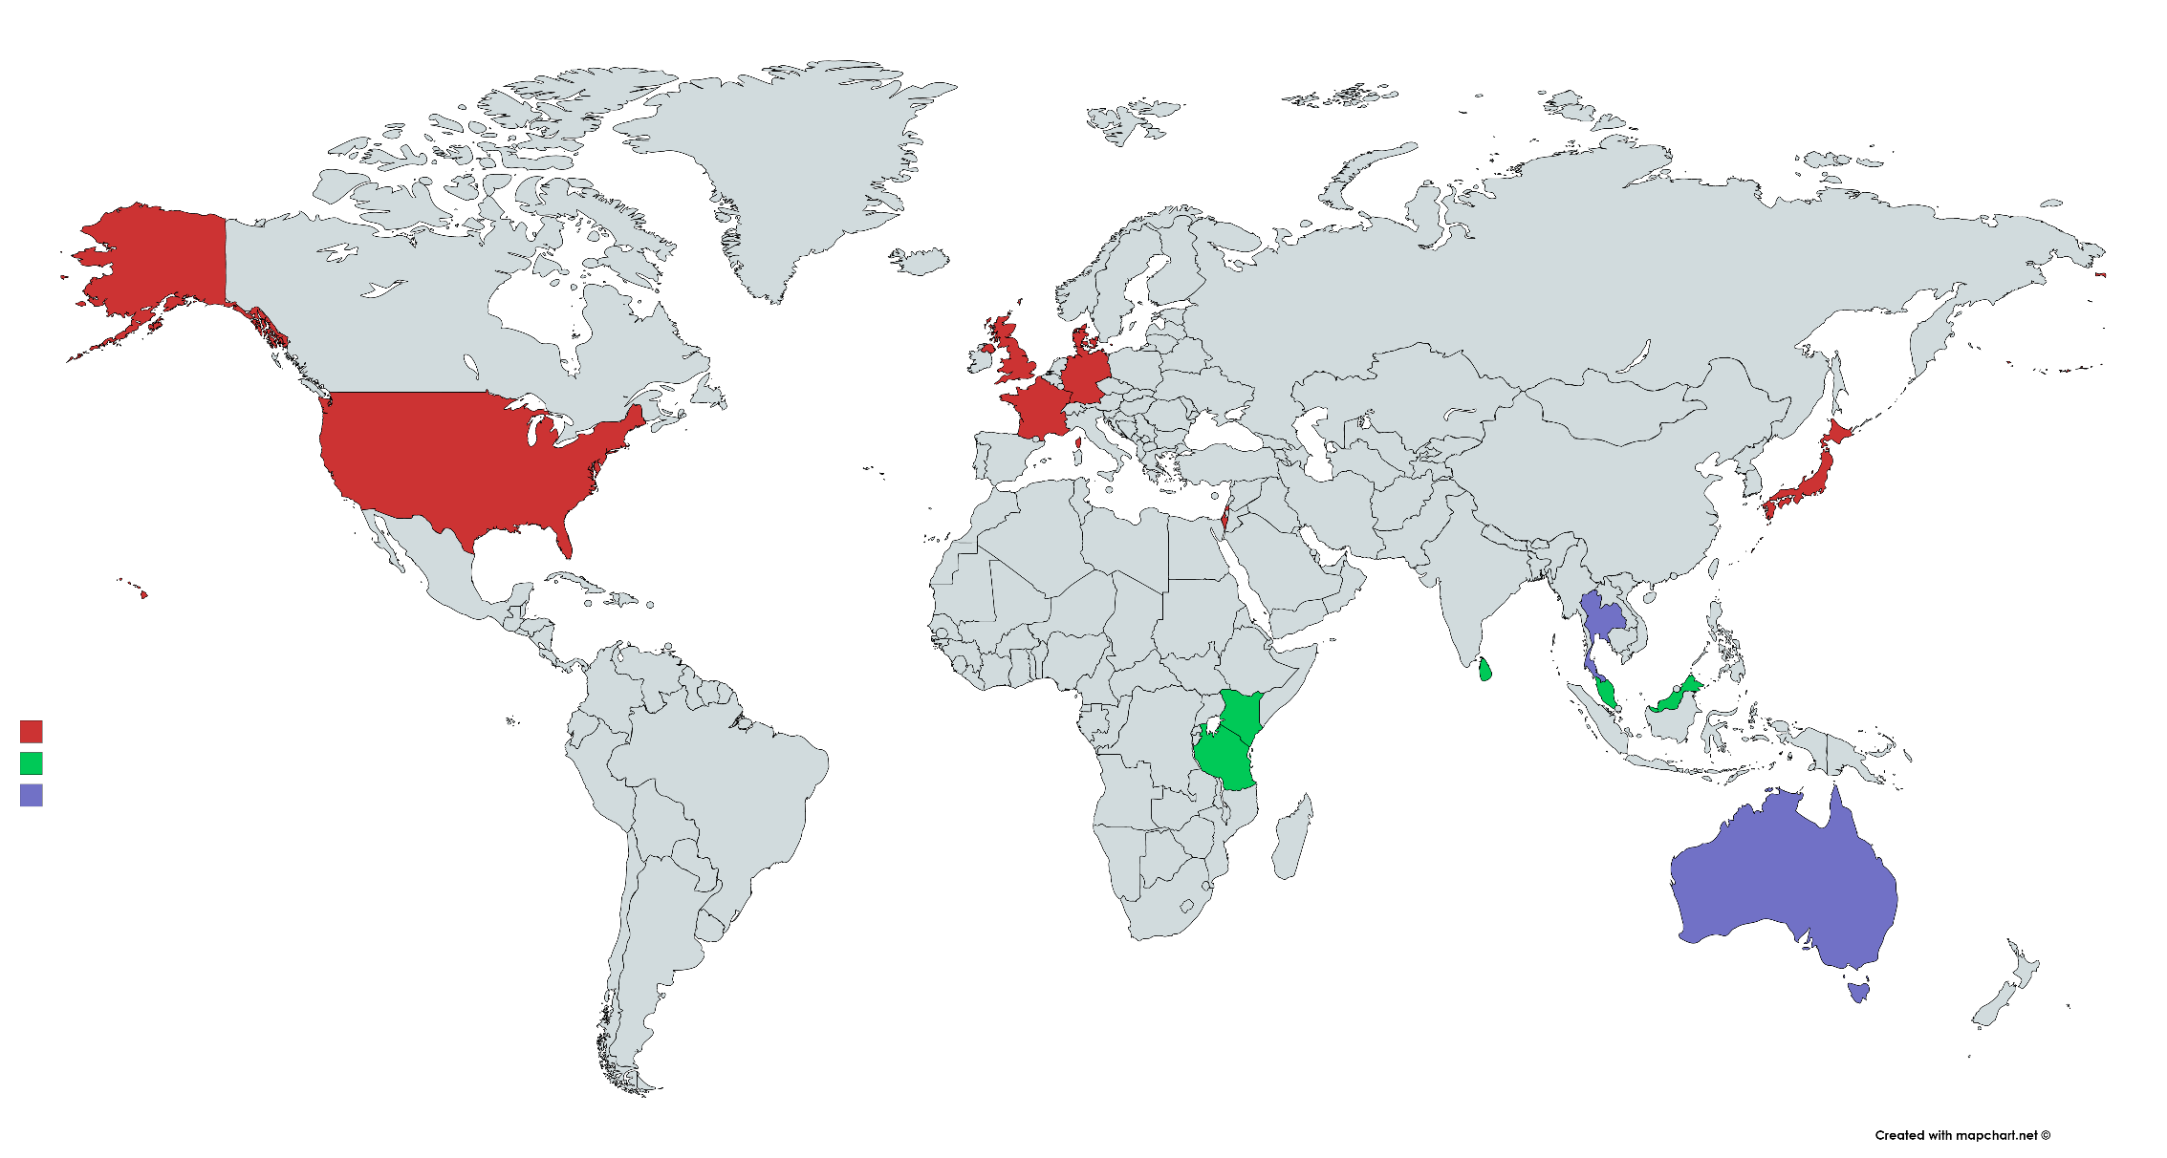
Reports of insecticide resistance in “modern” bed bugs
DENMARK
Pyrethroids
Carbamates
UK
Pyrethroids
Carbamates
GERMANY
Pyrethroids
JAPAN
Pyrethroids
FRANCE
Pyrethroids
USA
Pyrethroids
Organophosphates
Neonicotinoids
THAILAND
C. lectularius
Pyrethroids
DDT
Carbamates
Organophosphates
C. hemipterus
Pyrethroids
DDT
Carbamates
Organophosphates
ISRAEL
Pyrethroids
KENYA
Pyrethroids
C. lectularius
SRI LANKA
C. hemipterus
Pyrethroids
DDT
Carbamates
Organophosphates
MALAYSIA
DDT
Pyrethroids
C. hemipterus
TANZANIA
Pyrethroids
C. lectularius and C. hemipterus
AUSTRALIA
C. lectularius
Pyrethroids
Carbamates
DDT
C. hemipterus
Pyrethroids
Notes:
Recent research is providing solid evidence that bed bug populations have developed resistance to commonly used pyrethroids.

Slide 13
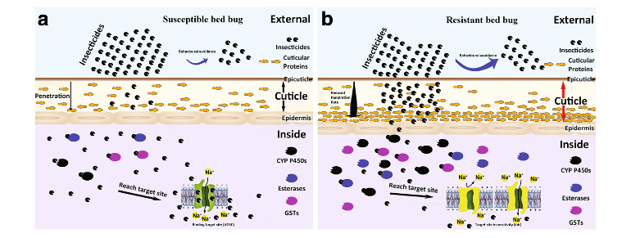
Resistance Mechanisms in Bed Bugs
Dang et al. 2017

Slide 14
Four Types of Resistance
Penetration – resistant insects may absorb the toxin slower than susceptible insects.
Target-site – the target site where the toxin usually acts in the insect has been genetically modified to reduce the product’s effects.
Metabolic – resistant insects may naturally detoxify or destroy the toxin faster than susceptible insects, or quickly rid their bodies of the toxic molecules.
Behavioral – resistant insects may detect or recognize a danger and avoid the toxin.
Insecticide Resistance Action Committee
Insecticide Resistance Action Comhttp://www.irac-online.org/about/resistance/mechanisms/

Slide 15
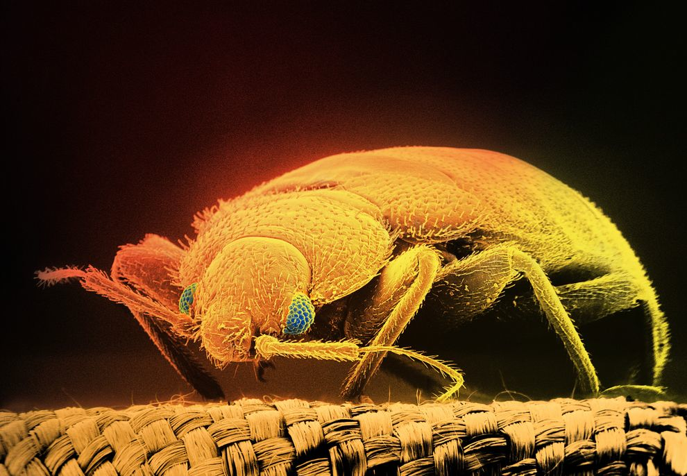
Penetration Resistance
Resistant bed bugs may absorb the toxin slower than susceptible insects.
Reduced insecticide penetration – thickening or remodeling of the cuticle may contribute to decreased insecticide penetration.
Photography by Tim Flach, Getty Images.

Slide 16
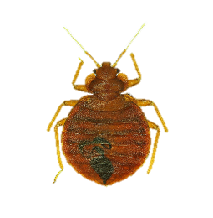
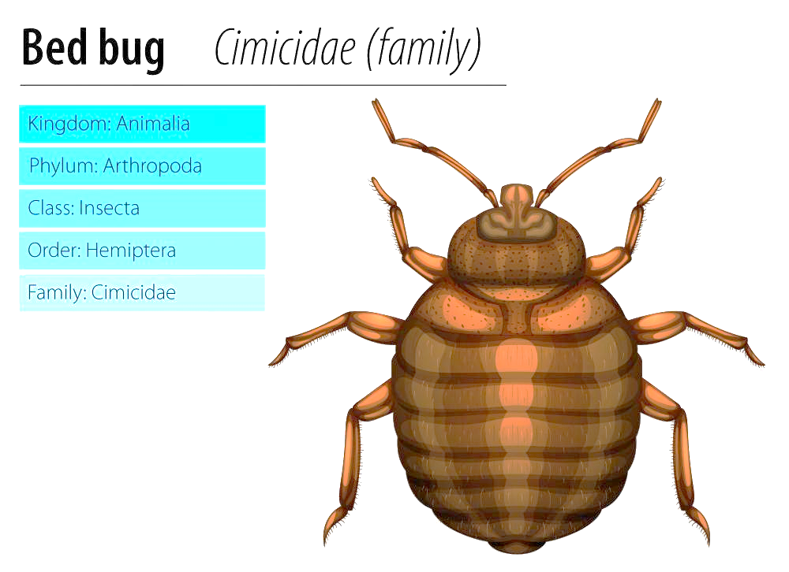

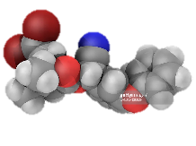

PENETRATION RESISTANCE
Cuticle (skin): penetration barrier
Reduced insecticide toxicity through cuticle (Koganemaru et al. 2013)
Thickened cuticle (Lilly et al. 2016) and extremely waxy cuticle
Over expression of cuticular protein genes associated with insecticide resistance (Bai et al. 2011, Mamidala et al. 2012, Koganemaru et al. 2013, Zhu et al. 2013)
Reduced penetration

Slide 17
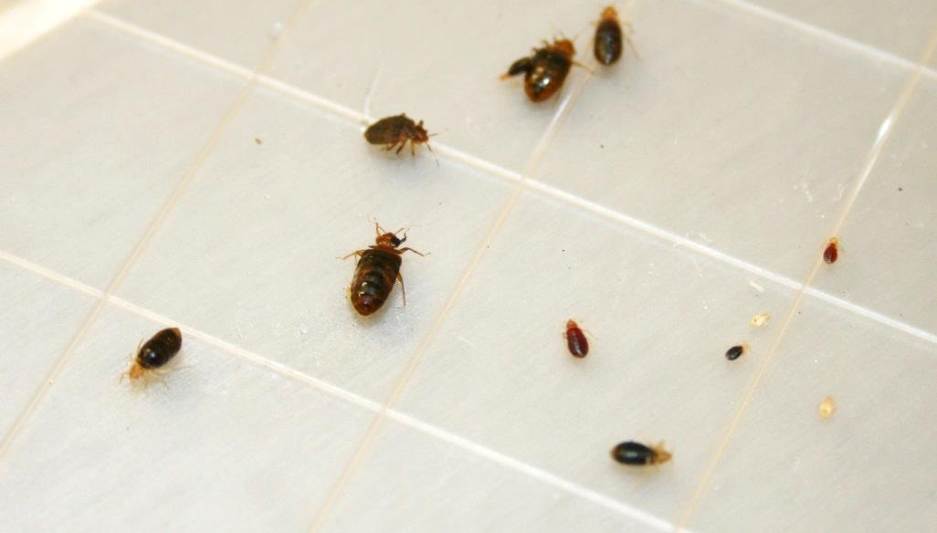
Target-site Resistance
The target site where the toxin usually acts in the insect has been genetically modified to reduce the product’s effects.
Commonly used insecticides target an ion channel and cause nerves to fire continuously, paralyzing and quickly killing the insects - resistant bed bugs may carry a mutation in the ion channel that prevents the pesticide from binding.

Slide 18


TARGET-SITE INSENSITIVITY
Binding site

Slide 19
1. VGSC: Pyrethroids, DDT
“Knockdown resistance (Kdr-type)”
C. lectularius:
- V419L / L925I (USA, Europe, Asia, Australia)
- I936F (Australia)
C. hemipterus
- M918I / L1014F (Australia, India, Thailand, Malaysia, Kenya)
2. AChEs: OPs, carbamates
“Altered AChEs”
(CAChE1, CAChE2)
3. GABA receptors: Cyclodienes (e.g. dieldrin), Fipronil
“Insensitive GABA receptors or Rdl-mutation”
4. nAChRs: Neonicotinoids ?
“Altered nAChRs”
Zhu et al. 2010, Durand et al. 2012, Yoon et al. 2008, Seong et al. 2010, Palenchar et al. 2015, Dang et al. 2015 and 2017, Romero and Anderson 2016
Voltage-gated sodium channel (VGSC), acetylcholinesterase (AChE), organophosphate (OP), gamma-aminobutyric acid (GABA), GABA-gated chlorine channel (GABA receptors), nicotinic acetylcholine receptors (nAChRs)

Slide 20
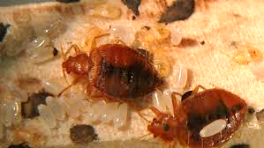
Metabolic Resistance
Metabolic enzymes (namely p450s, esterases, and GSTs), as well as ABC transporters) are involved.
A broad spectrum of activity against different insecticide classes.
Glutathione S-transferases (GSTs), ATP-binding cassette (ABC) transporters

Slide 21
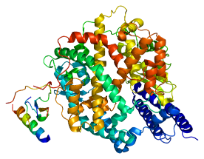
METABOLIC RESISTANCE
Detoxifying enzymes
Binding site

Slide 22
Detoxify insecticides by metabolic enzymes
  P450s Overexpression of genes
  Increased enzymatic activity
  Inhibition by chemicals (synergists)
  Esterases Overexpression of genes
  Increased enzymatic activity
  Inhibition by chemicals (synergists)
  GST Overexpression of genes
  Increased enzymatic activity
ABC Transporters Overexpression of genes
Increased efficiency of toxin removal
Adelman et al. 2011, Zhu et al. 2010 and 2013, Romero et al. 2009, Hardstone et al. 2015. Mamidala et al. 2012.

Slide 23
Physiological Resistance
Multiple mechanisms may contribute to pyrethroid resistance simultaneously in a single bed bug population (Adelman et al. 2011, Bai et al. 2011, Mamidala et al. 2012, Zhu et al. 2013).
Penetration resistance (cuticular proteins), target site insensitivity (kdr-type), metabolic resistance (metabolic detoxifying enzymes P450s and esterases, ABC transporters)(Yoon et al. 2008, Zhu et al. 2010, Adelman et al. 2011, Koganemaru et al. 2013, Mamidala et al. 2011 and 2012).

Slide 24
MULTIPLE RESISTANCE MECHANISMS
Detoxifying enzymes
Reduced penetration
Target site insensitivity
Adelman et al. (2011)
Mamidala et al. (2012)
Zhu et al. (2013)

Slide 25
Resistance Mechanisms & Reported to
Cuticular.
  Organophosphates, Carbamates, Organochlorines, Pyrethrin/Pyrethroids
  Tolerance: Silicates, Pyrroles
Target-site Insensitivity.
  Organochlorines, Pyrethrin/Pyrethroids
Metabolic.
  Organophosphates, Carbamates, Organochlorines, Pyrethrin/Pyrethroids, Neonicotinoids, Pyrroles
Zhu et al. 2010, Durand et al. 2012, Yoon et al. 2008, Seong et al. 2010, Palenchar et al. 2015, Dang et al. 2015 and 2017, Romero and Anderson 2016, Ashbrook et al. 2017

Slide 26
Behavioral Resistance
Resistant insects may detect or recognize a danger and avoid the toxin.
Stimulus-dependent behaviors (e.g. irritability and repellency).
  Excito-repellency in bed bugs (Romero et al. 2009)
  Potential behavioral resistance
Understand bed bugs’ unique behavior.

Slide 27
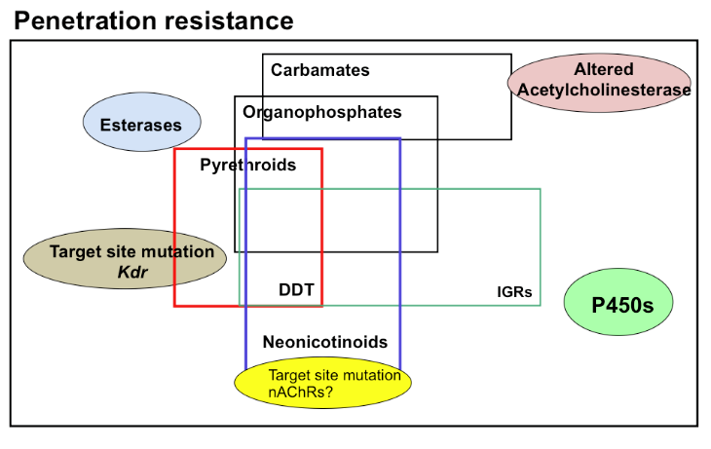
Multiple resistance, and cross resistance?
Cross resistance: the mutation makes it resistant to other insecticides (e.g. pyrethroids & OCs)

Slide 28
How can we use information on insecticide
resistance for resistance management?
Target-site insensitivity
- Monitor resistance
Metabolic resistance
- Development of chemicals that inhibit detoxifying enzymes associated with resistance (synergists).
Penetration resistance
- Development of insecticides and formulations to enhance insecticide penetration through the cuticle.

Slide 29

Doggett 2018

Slide 30
Factors Affecting Bed Bug Control
The extent of the infestation.
How well the area is prepared (hiding places removed, bed isolated, laundering of linens, etc.).
The quality and coverage of the pesticide application.
The targeting of all life stages.
Whether or not the bed bug population has developed resistance either to the specific pesticide or to the class of pesticides.

Slide 31

Integrated approaches for management of pesticide resistance
Integrated Pest Management (IPM) approach is the most likely strategy to successfully eliminate bed bugs.
Integrated approaches for management of potentially resistant bed bugs.
Choose most appropriate treatment options based on:
  Level of infestation
  Level of clutter
  Square footage
  Customer needs
  Structure types

Slide 32
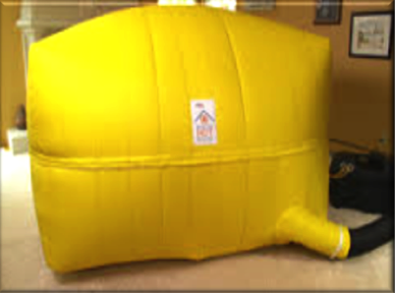
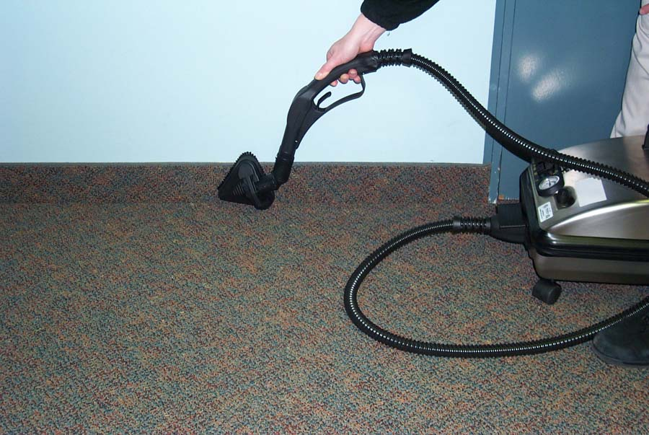

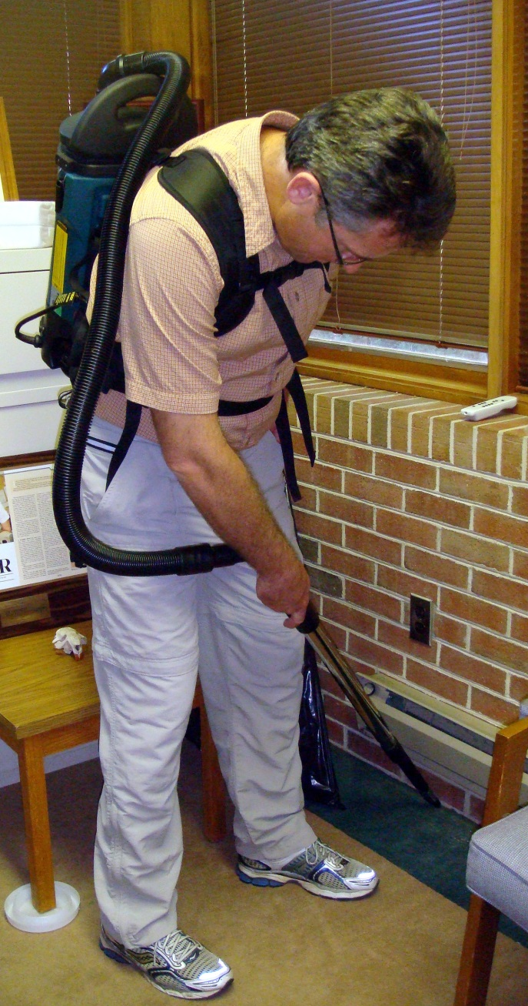

Non-chemical methods
Becoming the primary methods used in combination with chemical methods.
  Heat (>122°F)
  e.g. Dryer, steam, heat container
  Cold
  e.g. Freezer, liquid CO₂
  Vacuuming
  Isolation
  e.g. Encasement, bag infested items

Slide 33

Chemical Methods
> 300 EPA registered products.
Seven chemical classes of pesticides:
  Pyrethrins
  Pyrethroids
  Neonicotinoids
  Desiccants (DE, Cimexa, Boric acid)
  Biochemicals (Cold pressed neem oil)
  Pyrroles (chlorfenapyr)
  Insect growth regulators
Dichlorvos (known as DDVP, an organophosphate) as a pest strip.

Slide 34
About 30 MoA

Slide 35
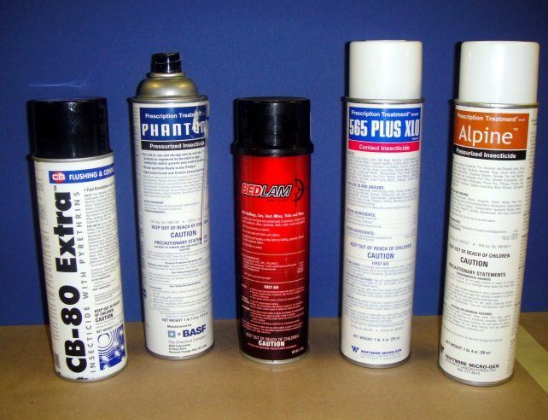
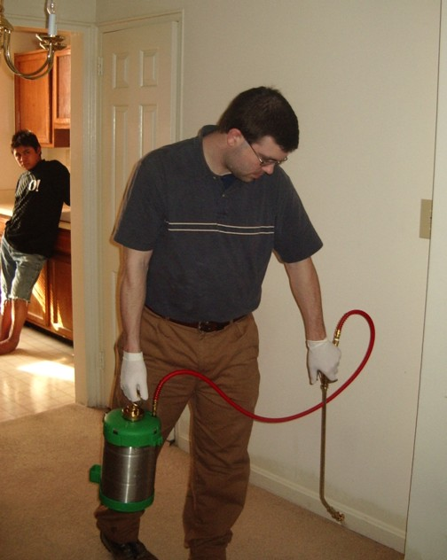
Resistance to pyrethroid products is very high.
Rotate pesticides with different mode of action.
Not all populations are resistant to the same products.
Use dual-action insecticides combining pyrethroids with neonicotinoids.
Both chlorfenapyr and a juvenile hormone analog formulation exhibited effectiveness on pyrethroid-resistant bed bugs (Goodman et al. 2013).

Slide 36
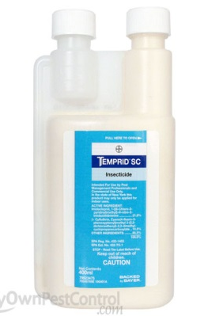
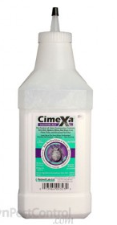
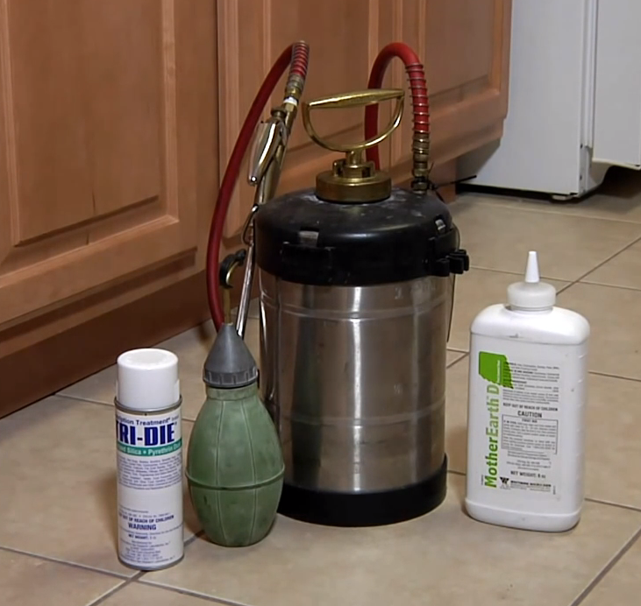
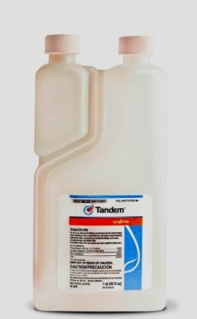
Many Legitimate Products
Novel liquid pesticide formulations
  Temprid (β-cyfluthrin & imidacloprid)
  Transport (bifenthrin & acetamiprid)
  Tandam (ƛ-cyhalothrin & thiamethoxam)
Chlorfenapyr
  pyrrole; “pro-insecticide”
Alpine Dust
  Dinotefuran and DE
CimeXa
  Amorphous silica gel
Products, vendors, or commercial services mentioned or pictured in this seminar are for illustrative purposes only and are not meant to be endorsements.

Slide 37
Summary of treatment options
Vacuuming
Isolation
  Encasements
  Contain infested items
  Make the bed an island
Freezing
  Liquid CO2
  Chest freezer
Heat
  Clothes dryer
  Steam
  Container
  Whole unit
Pesticides
  Spray
  Dust

Slide 38
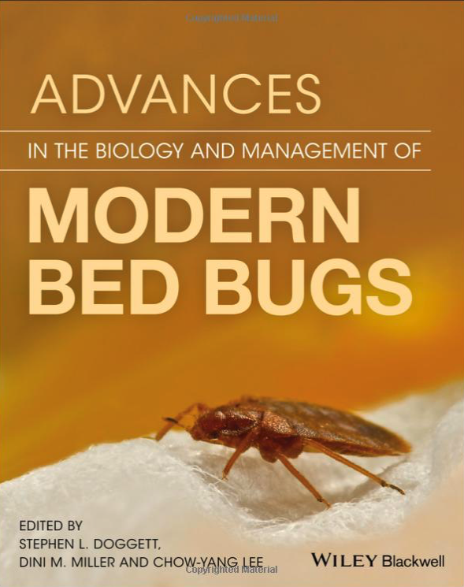




Resources (Examples)
http://www2.epa.gov/bedbugs
https://cals.arizona.edu/apmc/public-health-IPM.html
Zhu et al. 2010. Arch. Insect Biochem. Physiol., 73: 245-257. doi:10.1002/arch.20355
Zhu et al. 2016. Insects. 7(1), 2. doi:0.3390/insects7010002
Dr. Alvaro Romero. New Mexico State University. http://aces.nmsu.edu/faculty/romero/index.html
Romero and Anderson, 2016. Journal of Medical Entomology. 53(3): 727-731
Dang et al. 2017. Parasites & Vectors. 10: 318. DOI 10.1186/s13071-017-2232-3
Book: Advances in the Biology and Management of Modern Bed Bugs, edited by Doggett, Miller and Lee. 2018. Wiley-Blackwell.
Acknowledgements
Drs. Dawn H. Gouge & Alfred J. Fournier, University of Arizona
Dr. Alvaro Romero, New Mexico State University
Dr. Changlu Wang, Rutgers University
Dr. Fang Zhu, Penn State University
Dr. Stephen L. Doggett, University of Sydney

Slide 39

Contact:
Shujuan (Lucy) Li, Ph.D.
Assistant in Extension
Public Health IPM
University of Arizona
Maricopa Agricultural Center
37860 W. Smith-Enke Road
Maricopa, AZ 85138-3010
lucyli@email.arizona.edu

